Slide 1

UNIVERSITY INSTITUTE OF ENGINEERING
DEPARTMENT OF AIT - CSE
Bachelor of Engineering (CSE)
Security and Data Privacy Laws and Standards (21CSF-433)
By: Ms. Merry K.P(E12903)
Assistant Professor
AIT CSE
Lecture -6
Multilevel databases, Proposals for Multilevel security.
DISCOVER . LEARN . EMPOWER

Slide 2
Chapter | Course Objectives
1. | Exhibit knowledge to secure corrupted systems, protect personal data, and secure computer networks in an organization.
Chapter | Course Outcomes
1. | After completion of this course, the student will be able to Know how to secure corrupted systems. Aware of personal data protection and secured networking.

Slide 3
Contents
1.1 Designing Trusted Operating Systems
Multilevel databases
Proposals for Multilevel security

Slide 4
Multilevel Database
A Multilevel Database provides granular security for data depending on the sensitivity of the data field and clearance of the user for both writing and reading data.
So far, we have considered data in two categories sensitive or non-sensitive.
We have mentioned some data items being more sensitive than others, but we have two options either allow or don’t allow access to the data.

Slide 5
Cont…
Based on the following three principles the data are stored in DB
Security of a Single Element: may differ from the security of other elements of the same record or other values of the same attribute.
Categories of Data: sensitive and non-sensitive are insufficient to represent some security situations. Therefore, several grades or levels of security may be needed. Typically, the security grades form a framework.
Security Aggregate: a sum, a count, or a group of values in a database may differ from the security of the individual elements. The security aggregate may be higher or lower than that of the individual elements because it's collective.

Slide 6
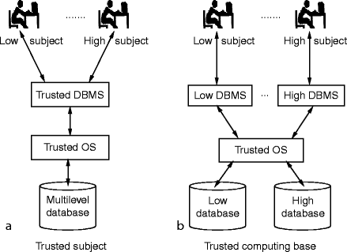
Multilevel Databases

Slide 7
Multilevel Security
Multilevel security is a security policy that allows you to classify objects and users based on a system of hierarchical security levels and a system of non-hierarchical security categories.
Multilevel security provides the capability to prevent unauthorized users from accessing information at a higher classification than their authorization, and prevents users from declassifying information
The idea of multi-level security is that some data are more sensitive than others.
We arrive at a slight problem when we try to formalize a multi-level security model using the most important model.

Slide 8
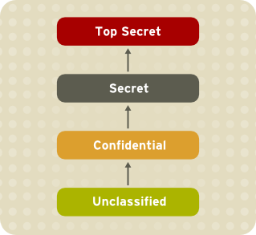
Multilevel Security
Consider the four traditional security classifications and their implied order
Unclassified ≤ Confidential ≤ Secret ≤ Top Secret

Slide 9
Advantages of Multilevel Security
Multilevel security enforcement is mandatory and automatic.
Multilevel security can use methods that are difficult to express through traditional SQL views or queries.
Multilevel security does not rely on special views or database variables to provide row-level security control.
Multilevel security controls are consistent and integrated across the system, so that you can avoid defining users and authorizations more than once.
Multilevel security does not allow users to declassify information.

Slide 10
Multilevel security in DBMS
Multi-level secure database management system (MLS-DBMS) security requirements are defined in terms of the view of the database presented to users with different authorizations.
These security requirements are intended to be consistent with DoD secure computing system requirements. An informal security policy for a multi-level secure database management system is outlined, and mechanisms are introduced that support the policy.
Security constraints are the mechanism for defining classification rules, and query modification is the mechanism for implementing the classification policy. These mechanisms ensure that responses to users’ queries can be assigned classifications which will make them observable to the querying users.

Slide 11
Proposals for Multilevel Security
Separation
As we have already seen, separation is necessary to limit access. In this section, we study mechanisms to implement separation in databases. Then, we see how these mechanisms can help to implement multilevel security for databases.
Partitioning
The obvious control for multilevel databases is partitioning. The database is divided into separate databases, each at its own level of sensitivity. This approach is similar to maintaining separate files in separate file cabinets.
This control destroys a basic advantage of databases: elimination of redundancy and improved accuracy through having only one field to update. Furthermore, it does not address the problem of a high-level user who needs access to some low-level data combined with high-level data.
Nevertheless, because of the difficulty of establishing, maintaining, and using multilevel databases, many users with data of mixed sensitivities handle their data by using separate, isolated databases.

Slide 12
Proposals for Multilevel Security
Encryption
If sensitive data are encrypted, a user who accidentally receives them cannot interpret the data. Thus, each level of sensitive data can be stored in a table encrypted under a key unique to the level of sensitivity. But encryption has certain disadvantages.
First, a user can mount a chosen plaintext attack. Suppose party affiliation of REP or DEM is stored in encrypted form in each record. A user who achieves access to these encrypted fields can easily decrypt them by creating a new record with party=DEM and comparing the resulting encrypted version to that element in all other records. Worse, if authentication data are encrypted, the malicious user can substitute the encrypted form of his or her own data for that of any other user. Not only does this provide access for the malicious user, but it also excludes the legitimate user whose authentication data have been changed to that of the malicious user.

Slide 13
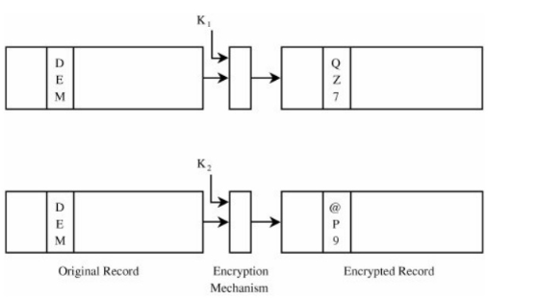
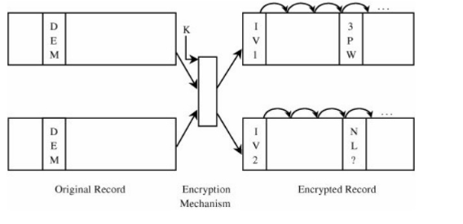
Different Encryption Keys

Slide 14
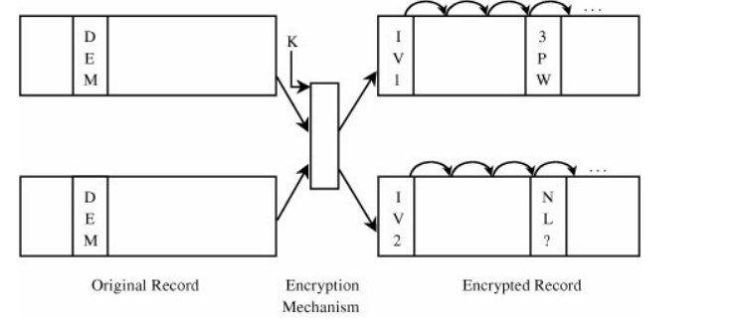
Block Chaining

Slide 15
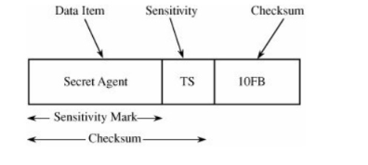
Integrity Lock

Slide 16
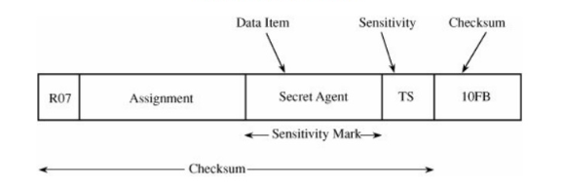
Cryptographic Checksum

Slide 17
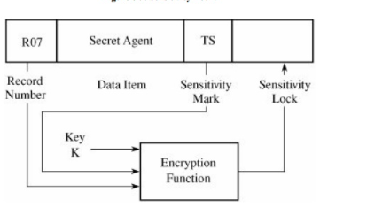
Sensitivity Lock

Slide 18
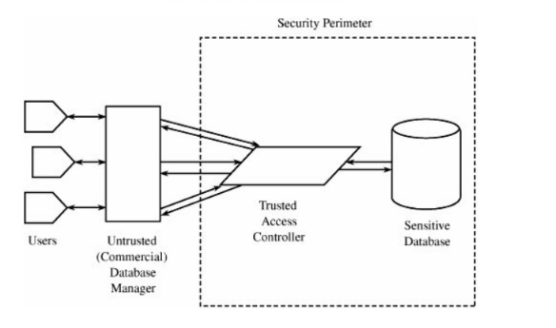
Trusted DB Manager

Slide 19
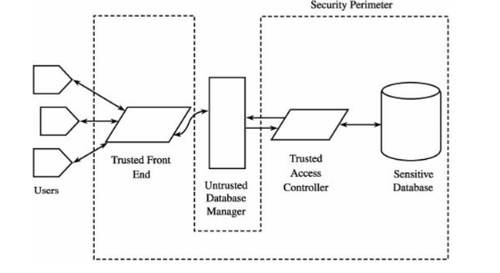
Trusted Front End

Slide 20
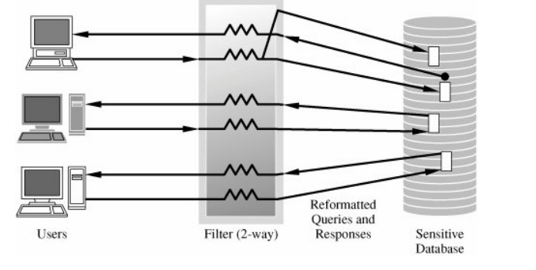
Commutative Filters

Slide 21
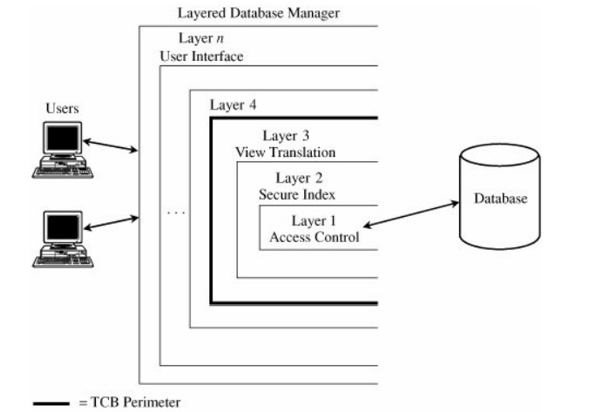
Secure DB Decomposition

Slide 22
Summary
Introduction to essentials requirements of Trusted Operating System (TOS)
Importance of sensitive data & inference of data
Need of multilevel databases & security

Slide 23
Home Work
Q1. What are the three principles used multilevel DB?
Q2. List down the types of attack in inference.

Slide 24
References
Text Books:
V. D. Dudeja ,”Cyber Crime and Law Enforcement”, Commonwealth Publishers, 2003.
C. Davis,”IT Auditing: Using Controls to protect Information Assets”, TMH, 2011.
Reference Books:
G.E. Kennedy & L.S.P. Prabhu, “Data Privacy Law: A Practical Guide”, Interstice; 2nd edition, 2017.
June M. Sullivan & Shannon B. Hartsfield, “HIPAA: A Practical Guide to the Privacy and Security of Health Data”, American Bar Association; 2nd edition, 2020.
Journals:
Pankaj Sharma, “Cyber Surveillance & Data Privacy Law: The Reconciliation”, https://www.researchgate.net/publication/335378068_Cyber_Surveillance_Data_Privacy_Law_The_Reconciliation?channel=doi&linkId=5d60da79a6fdccc32cccd626&showFulltext=true, 2019.
Online References:
MLDB Security Models: https://www.youtube.com/watch?v=47mVjXHng5Y
Know and protect your sensitive data: https://www.youtube.com/watch?v=gqmUVaG0JJs

Slide 25
THANK YOU
For queries
Email: merry.e12903@cumail.in

